Slide 1
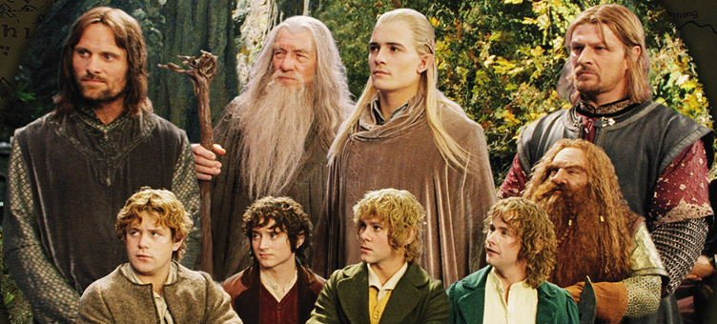

The Fellowship of the Data
Source:myblogs.pw
Sev Leonard
sev@thedatascout.com
gizm0_0

Slide 2
Greetings
Some bits about me

Slide 3
Class info
Tutorial content & setup instructions: https://github.com/gizm00/pycon2016
All http requests are handled by the pycon2016_lamp Docker container

Slide 4
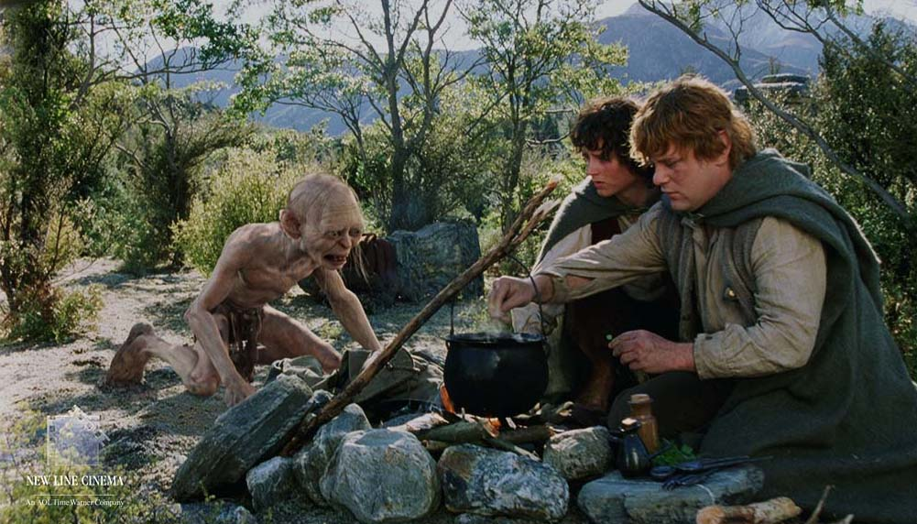
About the tutorial
Gather campground information from multiple sources to create The One Camping Database, presently hosted at www.campnear.me
Source:artistthinks.wordpress.com

Slide 5
About the data
Data sources include the Recreational Information Database (RIDB), US Forest Service (USFS) websites, and recreation.gov
RIDB API – campground name, lat/long
USFS – scrape additional campground information
recreation.gov - scrape reservation availability by form navigation

Slide 6
Agenda
Section 1: Web data best practices
Section 2: Gathering data from the web
15min Break
Lab 2: RIDB API, Scraping USNF pages, recreation.gov form navigation
15min Break
Section 3: Data organization and database design lite
Lab 3: Merging data from Lab 2
Section 4: Pipelining
Lab 4: The One Pipeline

Slide 7

Section 1: Web data best practices
Source:kaiju.wikidot.com

Slide 8
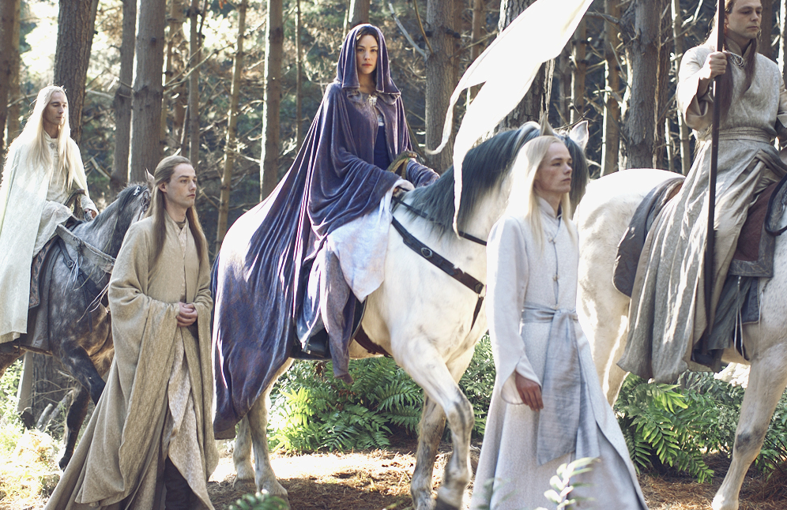
1. Web data is ephemeral
Source:lotr.wikia.com
Format, availability, access requirements can change at any time

Slide 9
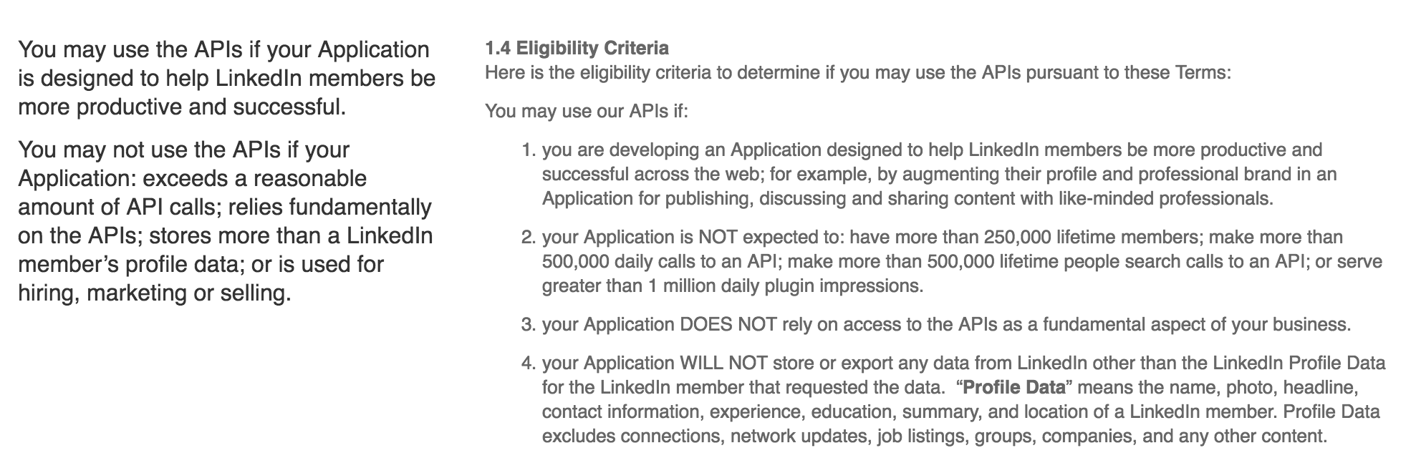
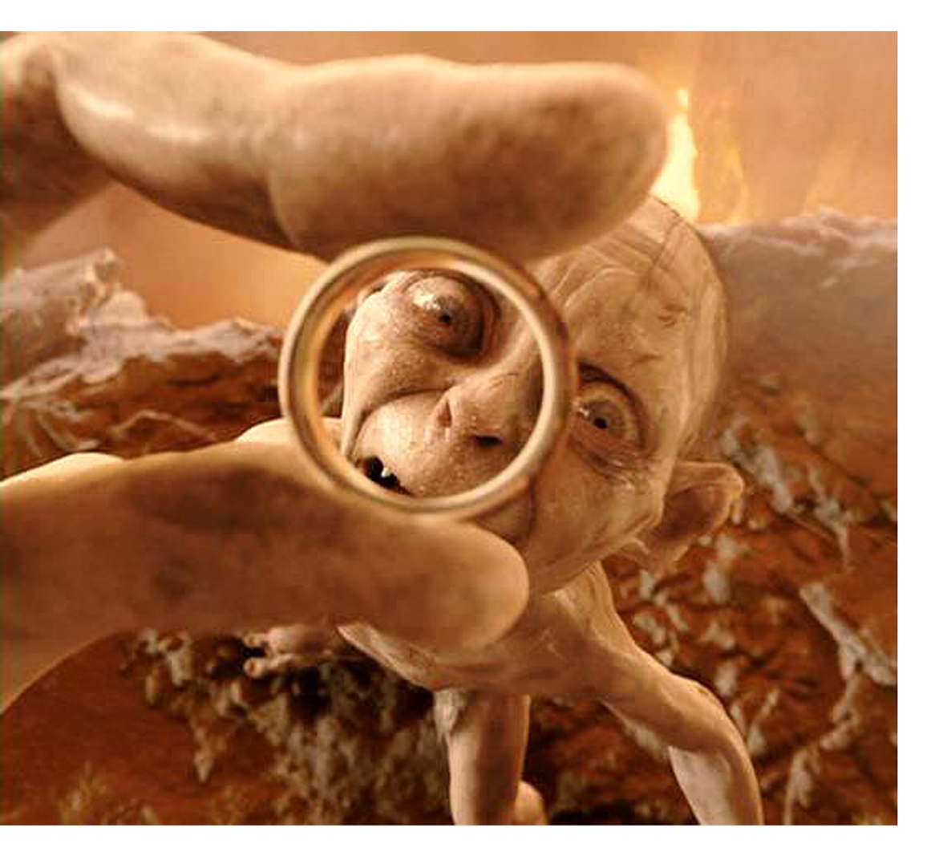
2. Just because you can get the data…
https://developer.linkedin.com/legal/api-terms-of-use
Source:realitysandwich.com

Slide 10
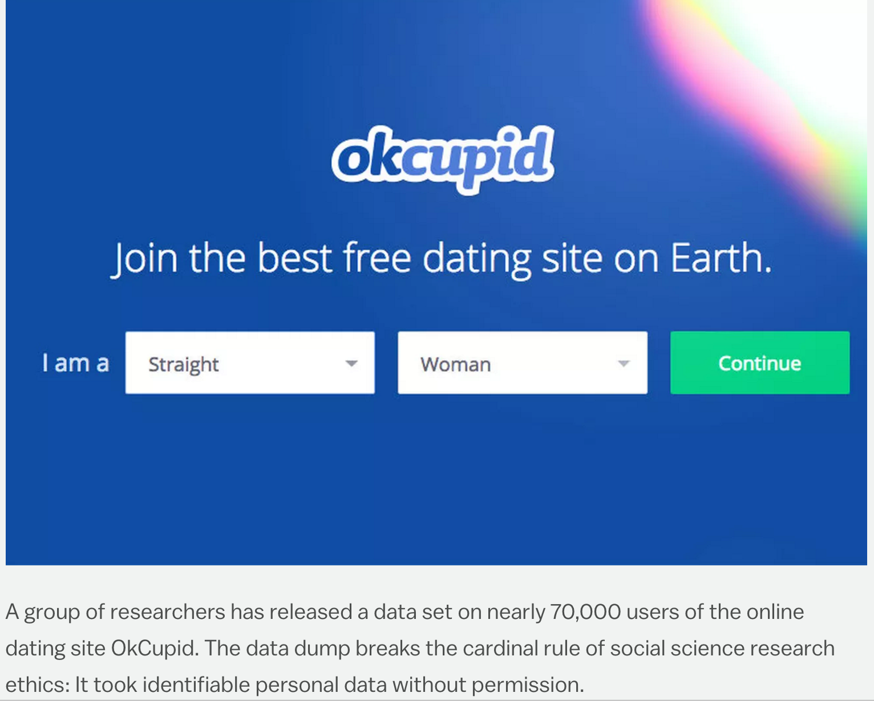

… doesn’t mean you can use it
http://www.vox.com/2016/5/12/11666116/70000-okcupid-users-data-release
Source:doblu.com

Slide 11
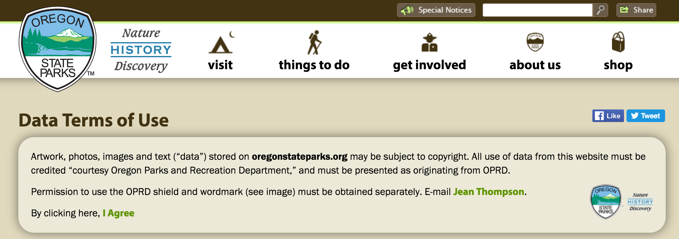
3. Terms of Use - attribute properly
Source:oregonstateparks.org

Slide 12
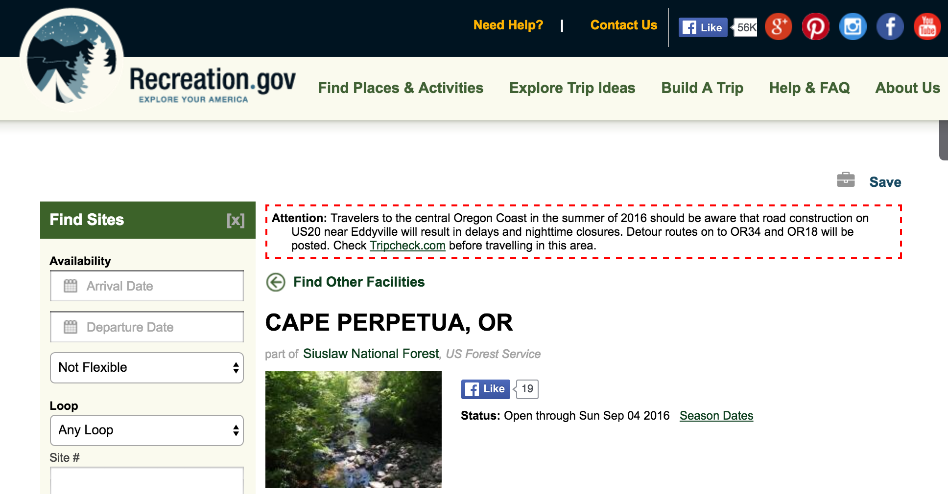

4. Be mindful of the resources of others
Source:lotr.wikia.com

Slide 13
5. Web (any) data is wrong
USFS data for region 6, Oregon and Washington State, has 80% accuracy for latitude and longitude points.
Ex. Driving directions to campgrounds (find a borked example)
Campground usage is light at Lost Lake

Slide 14
Section 1 Summary
Data you gather from the web may not be there tomorrow.
Attribute correctly.
Abuse of resources may result in blacklisting, banning, etc.
Data is wrong. Proceed accordingly!

Slide 15
Agenda
Section 1: Web data best practices
Section 2: Gathering data from the web
15min Break
Lab 2: RIDB API, Scraping USNF pages, recreation.gov form navigation
15min Break
Section 3: Data organization and database design lite
Lab 3: Merging data from Lab 2
Section 4: Pipelining
Lab 4: The One Pipeline

Slide 16
Section 2 – Gathering data from the web
Review: tidy data principles
Each variable is a column
Each observation is a row
Each type of observational unit is a table
Source: Wickham 2014 http://www.jstatsoft.org/v59/i10/paper
Observation: campground
Variables: lat/long, name, website, etc
Observational unit: RIDB, USFS, recreation.gov

Slide 17
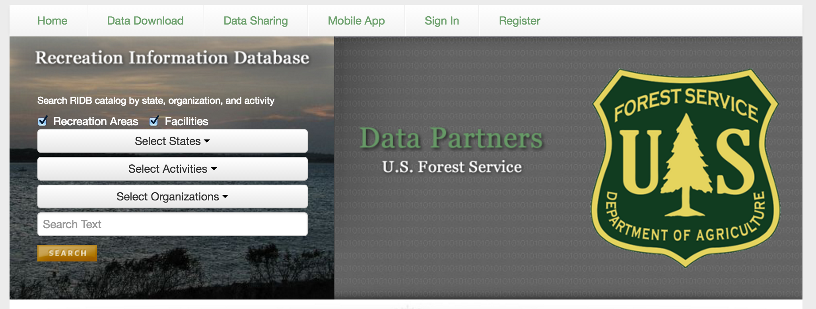
RIDB API
ridb.recreation.gov

Slide 18
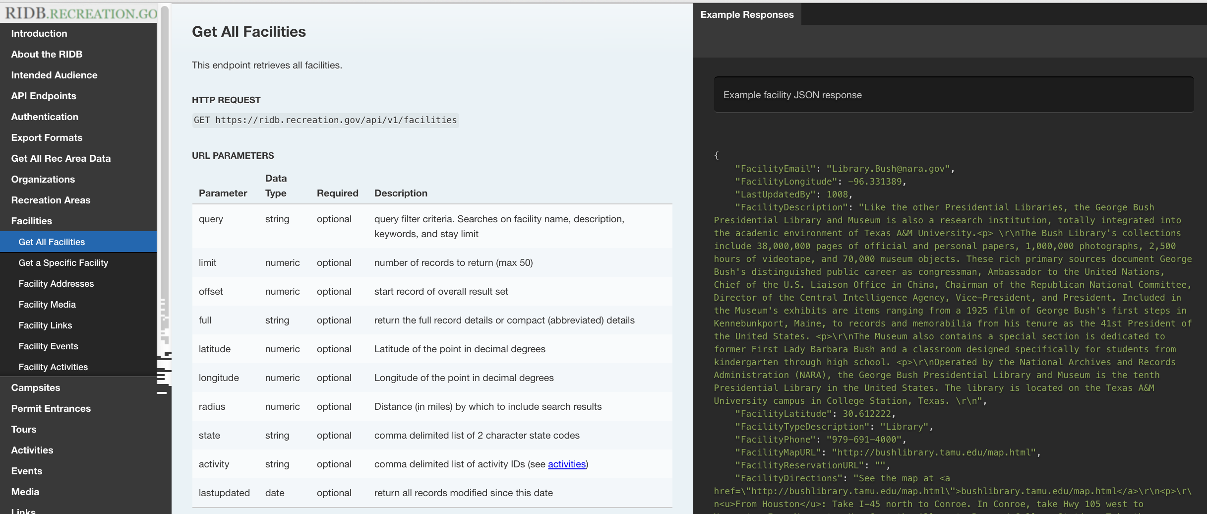
RIDB API Documentation
http://usda.github.io/RIDB

Slide 19
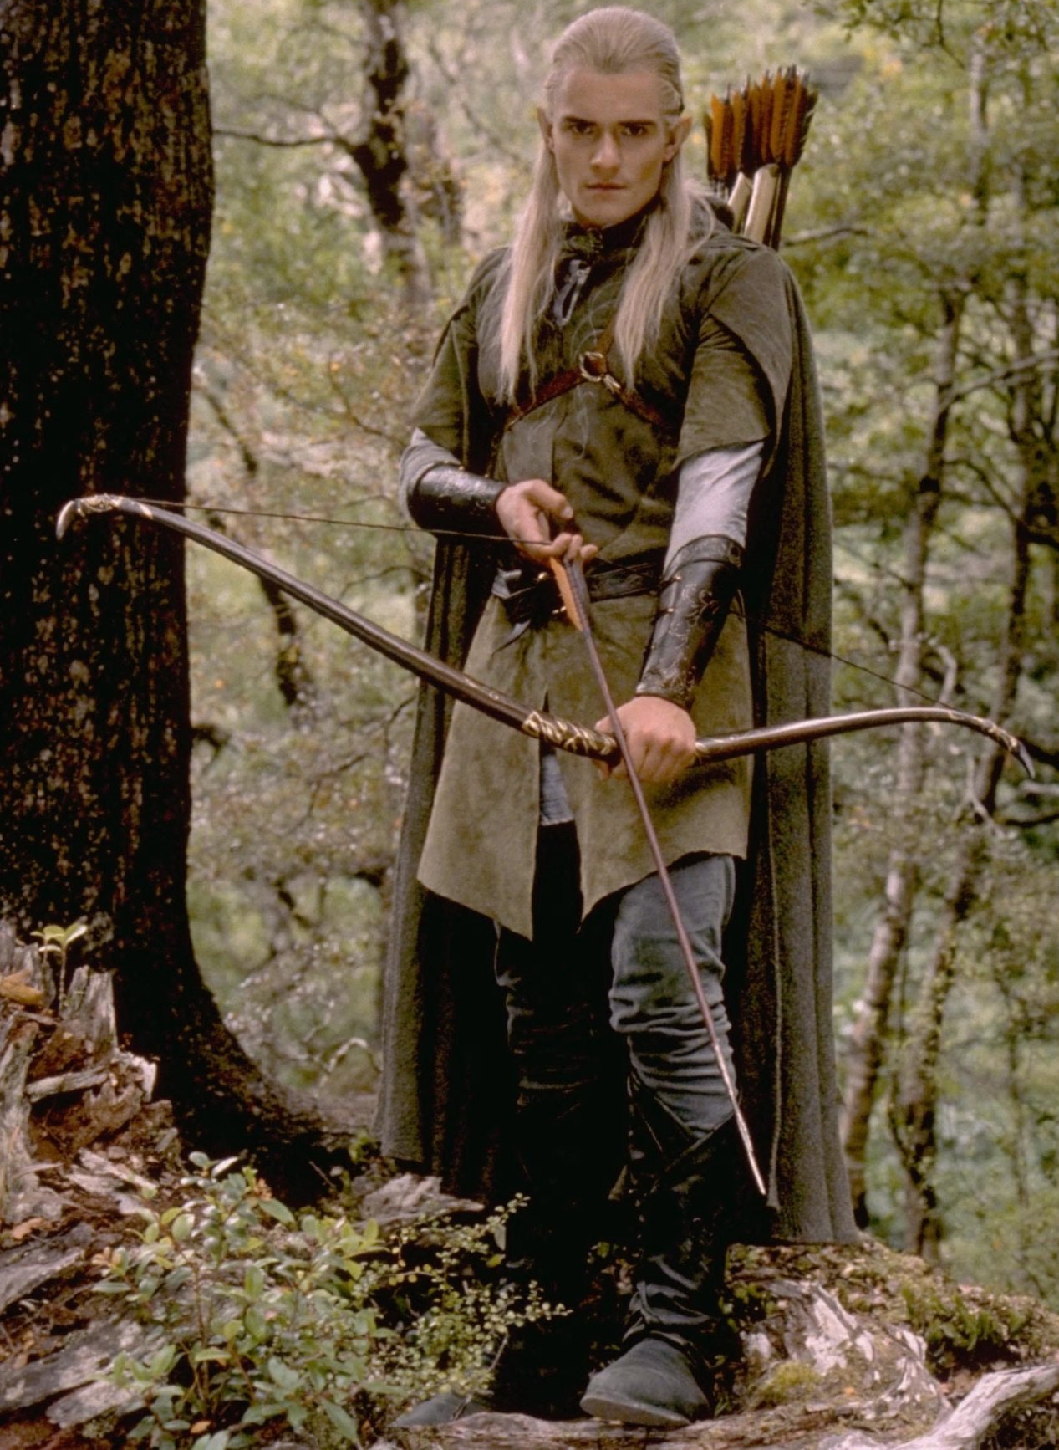
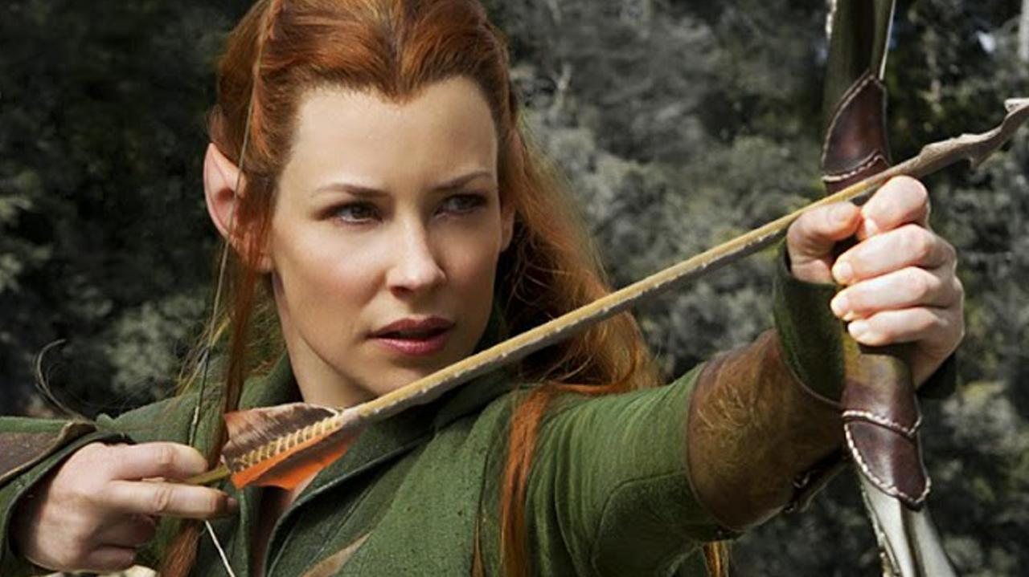
RIDB data notes
Only has campgrounds that can be reserved – no first come, first serve
Missing reservation URLs
Lat / Longs not guaranteed to be accurate

Slide 20
To the Lab!

Slide 21
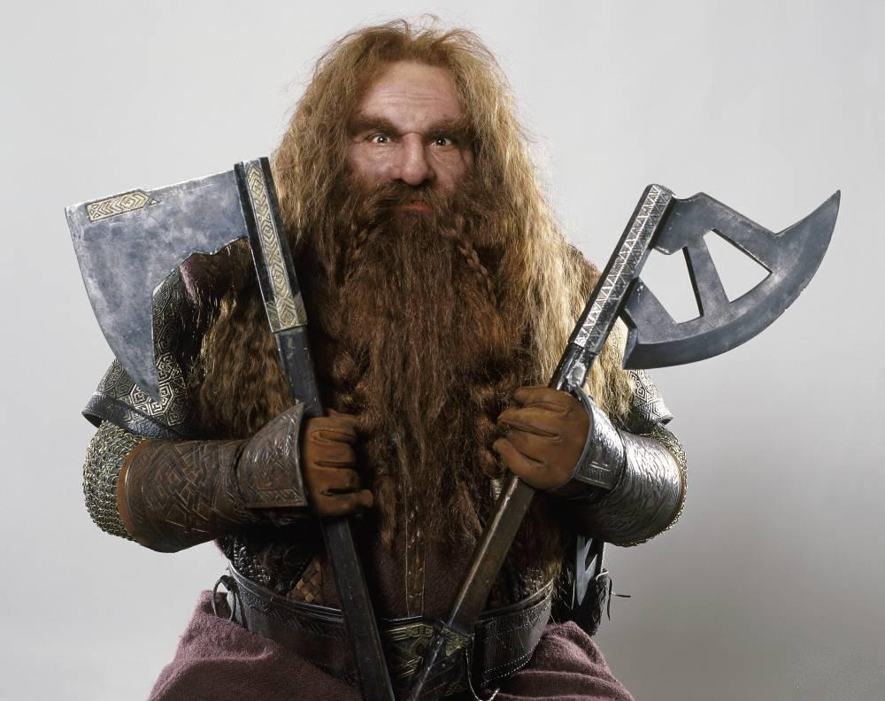
USFS Website scraping
Selenium
BeautifulSoup

Slide 22
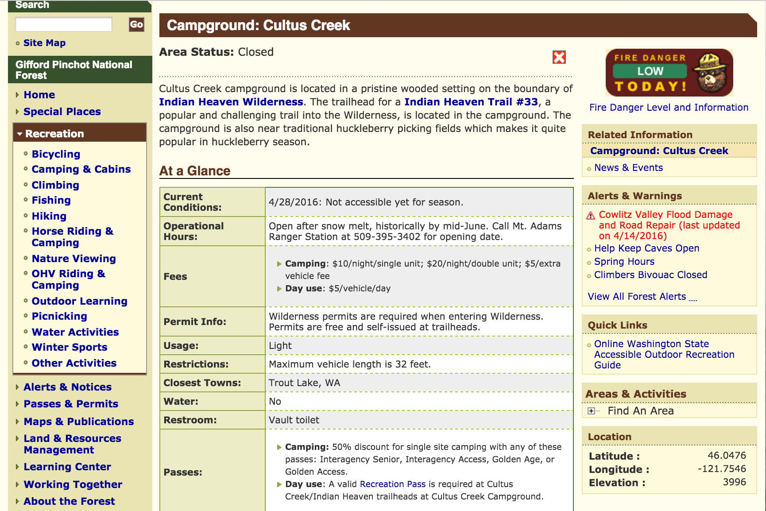

Slide 23
